Slide 1
A mini project presentation on CREATING X-SECTIONS USING Arcpy
Group Members
Suresh Bhandari (03)
Yashwant Singh (25)
Diwash Tamang (26)
Aashish Basnet (32)
Presented to:
Mr. Uma Shankar Panday
Department of civil and Geomatics Engineering

Slide 2
Introduction
The project uses the Arcpy to create the X-section of the river center line
The cross section is the perpendicular lines drawn across a line segments (river, roads etc.)

Slide 3
Arcpy
Arcpy is a Python scripting module for mapping purpose
It gets installed with ArcGIS for Desktop and is available to all licenses
Main Methods we used:
arcpy.Geometry.measureOnLine( arcpy.Geometry )
arcpy.da.SearchCursor( in_layer, list_of_field )
arcpy.da.InsertCursor(in_layer, list_of_field )
arcpy.Geometry.positionAlongLine( arcpy.Geometry )
arcpy.ddd.StackProfile( line_layer,DEM,savePath,graphName )

Slide 4
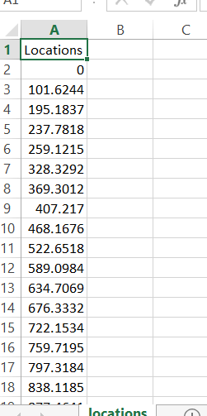
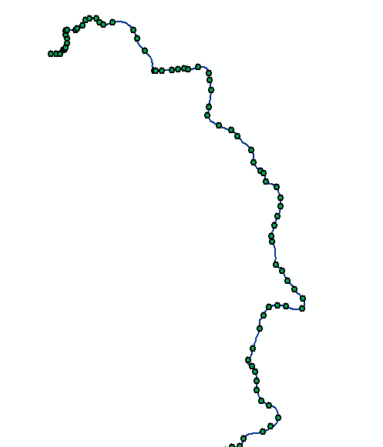

Method
Step 1:
Inputs:
Centerline shapefile
Point Shape file
Main Methods used:
Line.measureOnLine(Point)
Output:
csv file containing the chainage of each point along centerline

Slide 5
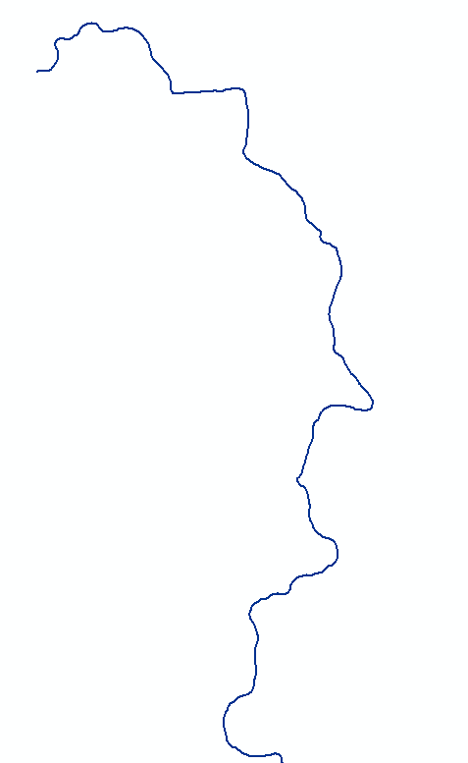
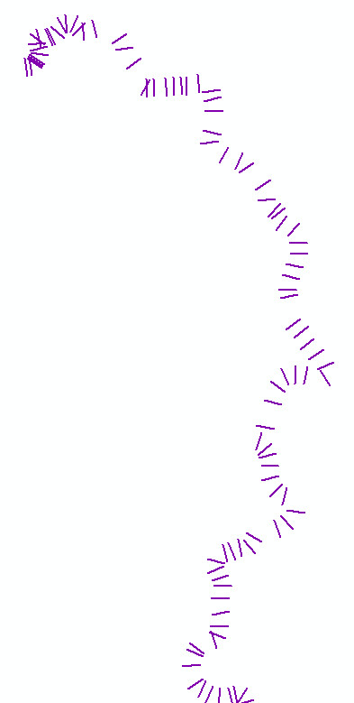

Method
Step 2:
Input:
Locations csv file
Centerline shapefile
Main Methods Used:
arcpy.CreateFeatureclass_management
arcpy.da.InsertCursor
AngleBetween(p1,p2)
GetLine(midPoint,angle,length):
Output
New Shape File containing lines perpendicular to centerline at chainages from csv file

Slide 6
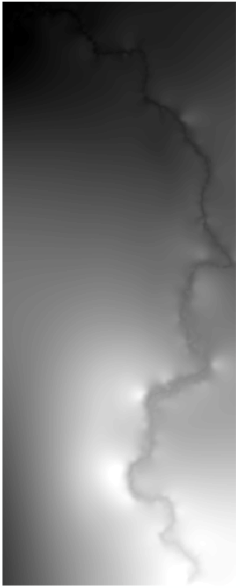
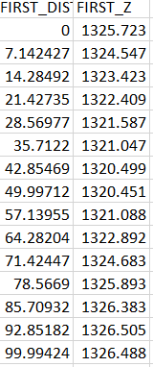
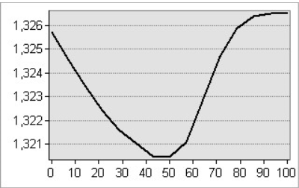
Method:
Step 3:
Input:
Shapefile containing the lines perpendicular to the CentreLine
DEM
Main Methods Used:
arcpy.ddd.StackProfile(layer,DEM,savePath_csv,)
arcpy.management.SaveGraph()
Output:
X-section Graphs in jpeg format
csv file containing x-section data of the perpendicular lines

Slide 7
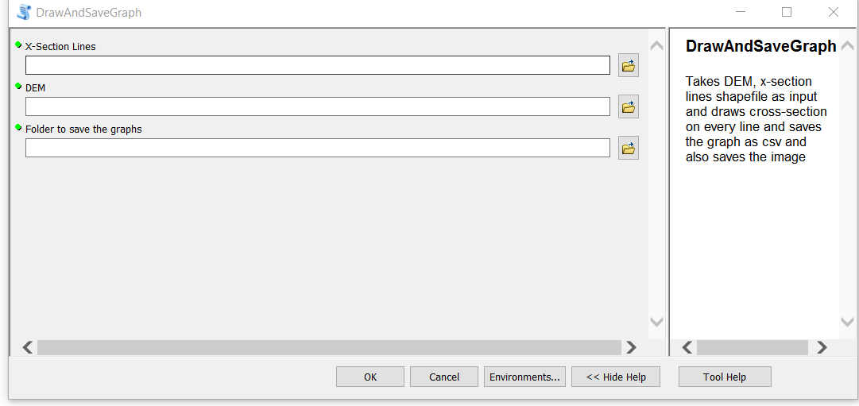
Toolbox
The toolbox created using the above python scripts are:

Slide 8
Application
Can be used for cross-section for roads and rivers.
The output cross-section data can be used for hydrological modelling, road cut fill calculation, mass-haul diagrams, etc

Slide 9
Demonstration

Slide 10
Thank you! Any Queries?

